Slide 1
INVESTMENT ASSIGNMENT SUBMISSION
Name: PAVAN M REDDY

Slide 2
<Abstract>
Spark Funds wants to invest $5 - $15 Million. They have provided us with data and some requiredments based on which they could make a decision on where to invest their money. They want to know the following:
The best investment type for them.
The most suitable countries for them to invest in.
The best sectors to invest in.
This presentation will take you through the analysis that will help Spark Funds make a decision on where they would want to invest their money

Slide 3
<Problem solving methodology>
Import Files
Find the top 9 countries by total investment
Pick the top 3 countries
Casefold permalink to match unique ids of both dataframes
Create a frame grouped by countries
Derive primary category from category_list
Merge companies and rounds 2 dataframes into master_frame
Create a frame with only the required investment types
Map primary category to primary sector
Find the representative value of the 4 investment types
Pick the appropriate investment type for Spark Funds
Pick the 3 sector with most number of investments for the top 3 countries

Slide 4
<Analysis>
FINDING THE MOST SUITABLE TYPE OF INVESTMENT
Representative Amounts for different investments
As Spark Funds want to invest $5 - $15 Million, the most suitable investment type is Venture
Investment Type | Amount
Venture | 5000000
Angel | 275000
Seed | 400000
Private equity | 20000000

Slide 5
<Analysis>
FINDING THE MOST SUITABLE COUNTRY FOR INVESTMENT
9 of the most invested countries are:
Since Spark Funds wants to invest in English Speaking Countries, the best options are:
USA
Britain
Canada
USA | India | Israel
China | Canada | Germany
Britain | France | Japan

Slide 6
<Analysis>
FINDING THE BEST SECTORS FOR INVESTMENT
Since Spark Funds wants to invest in the most invested sectors by number, these are the best possible options:
USA | No. of Investments | BRITAIN | No. of Investments | CANADA | No. of Investments
Others | 8243 | Others | 507 | Cleantech / Semiconductors | 329
Cleantech / Semiconductors | 7849 | Cleantech / Semiconductors | 433 | Others | 326
Social, Finance, Analytics, Advertising | 5156 | Social, Finance, Analytics, Advertising | 318 | Social, Finance, Analytics, Advertising | 164

Slide 7
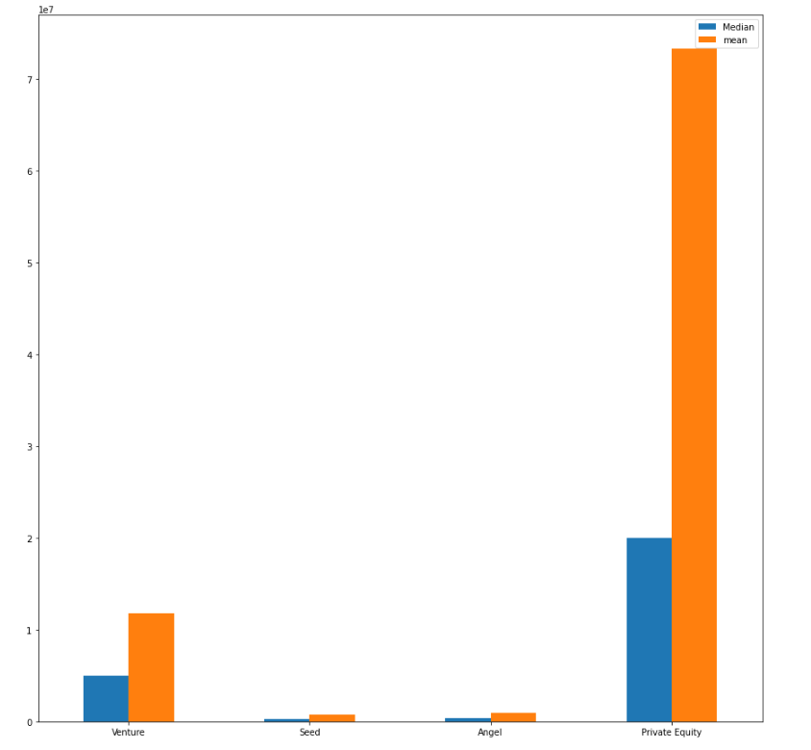
<Results>
PLOT TO SHOW THE REPRESENTATIVE AMOUNT OF THE 4 INVESTMENT TYPES
The 4 investment types are
Venture
Seed
Angel
Private Equity

Slide 8
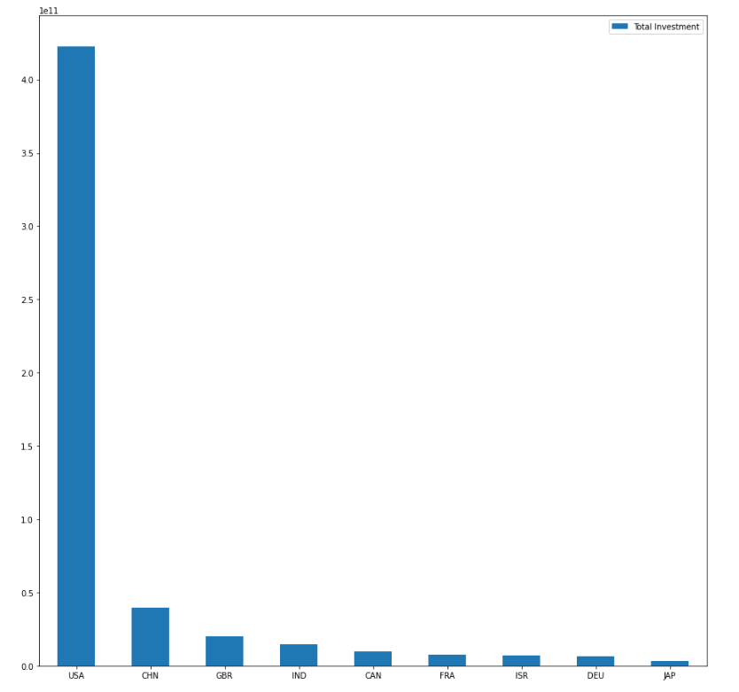
<Results>
PLOT OF THE VENTURE INVESTMENT IN THE TOP 9 MOST INVESTED COUNTRIES.
We can pick the top 3 English speaking countries
USA
Great Britain
Canada

Slide 9
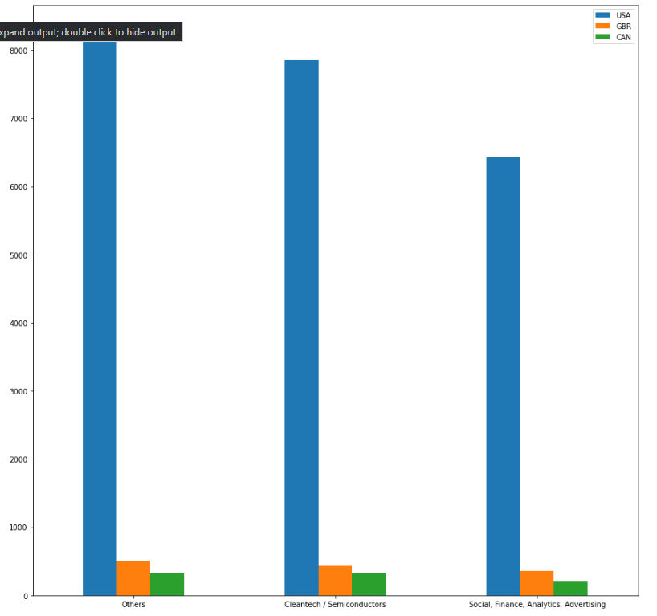
<Results>
PLOT OF THE NO. OF INVESTMENTS IN EACH OF THE TOP 3 SECTORS IN THE TOP 3 COUNTRIES.
Top 3 Sectors in the Top 3 Countries
Others
Cleantech/Semiconductor
SFAA(Social, Finance, Advertising and Analytics)

Slide 10
<Conclusions>
Based on the Requirements of Spark Funds
Investment amount of $5 – $15 Million.
In Investment friendly countries when most investments are occurring.
In Sectors where most investments are occurring.
I have found that
Venture Investment is the most suitable type of Investment.
The USA, Great Britain and Canada are the most investment friendly countries.
Others, Cleantech/Semiconductor and SFAA(Social, Finance, Advertising and Analytics) are the best sectors to invest in.

